Slide 1

The Online Voting System
By Brendan Mierau and Trevor Dayton

Slide 2
Problem Definition
There is often a large disconnect between management and the people beneath them.
How to solve this?
Making voting more accessible to more people
Driving down the cost of voting solutions
Making it more accessible to managers to get votes on many topics at any time
Notes:
There can be an exceedingly large amount of misunderstanding between management and users the same as between a government and its people. To gather feedback for what the users want, voting is one of the strongest strategies but the cost and time of the activity can make this strategy can be prohibitive.
Our project aims to make the process far more accessible and cost effective for business’s to implement using an android application. This allows everyone easy access to the system and eliminates the cost of posing new topics to the users. This allows a greater level of understanding about how users feel on certain topics and allows management to make more informed decisions.

Slide 3
Solution 1:
Reduced MVC Architecture
MySQL database
Notes:
The idea was to use a reduced MVC as the architecture. This essentially boiled down to not having a controller and using the model to handle the logic with the database directly. This simplified version is easier to implement for such a small project but isn’t very scalable or modifiable if we want to grow or change the system.

Slide 4
Solution 1: MySQL Database
Advantages
More power on how we want the database built structured and managed
Well established security
Scalability
Disadvantages
Doesn’t handle transactions well and is prone to data corruption
Setup and maintenance of hardware
Initial creation and implementation time
Notes:
This solution would allow more power on how to structure the database. This solution is more costly in the upfront capital into getting databases setup. This solution also has the advantage of being more environmentally friendly than in person voting as a small number of servers are needed for data collection.
This solution does have some disadvantages. The team is responsible for the initial setup and maintenance of the database which increases production time and complexity. This also increases the workload as the team will have to setup and manage the hardware.

Slide 5
Solution 1:
Reduced MVC Architecture
Firebase database
Notes:
The idea was to use a reduced MVC as the architecture. This essentially boiled down to not having a controller and using the model to handle the logic with the database directly. This simplified version is easier to implement for such a small project but isn’t very scalable or modifiable if we want to grow or change the system.

Slide 6
Solution 2
Same simplified MVC architecture from solution 1
Now is firebase integrated
Added functionality of a dynamic topic list
Notes:
This solution still uses the simplified MVC from solution 1 except we now integrate with firebase database. It also has a significant new feature for scalability and robustness. This feature is the dynamic topic list. In the previous iterations we had a static topic list that was only 5 topics and they could either be filled with created topics or empty. If empty then the button would simply not work. This was an inelegant solution as this limits the amount of topics that the manager can post as well as can be confusing for voters when certain topics simply do not work.

Slide 7

Solution 2
Advantages
Firebase is far simpler to implement
Has built in authentication for logins
Cloud storage
Minimal cost
Disadvantages
Less powerful
Platform dependent
Limited data migration

Slide 8
Final Solution
Improvements
Refactored into more of a traditional MVC structure
Added database access object
Notes:
This solution is based on solution 2 but the core architecture is refactored into a traditional MVC. This allows for greater modularity, scalability and maintenance as the controlling logic is separate from the model now. The other improvement we have is an addition of a database access object. This object simplifies the calls and data pushed to the data base as well as acting as an interface for the program.

Slide 9
Final Solution
Features
Single application for both user and manager
Login integrated with firebase
Dynamic voting list
Voting on topics
View the statistics on available topics in realtime
Create topics
Notes:
Pull it out of your ass

Slide 10
System Interfaces

Slide 11
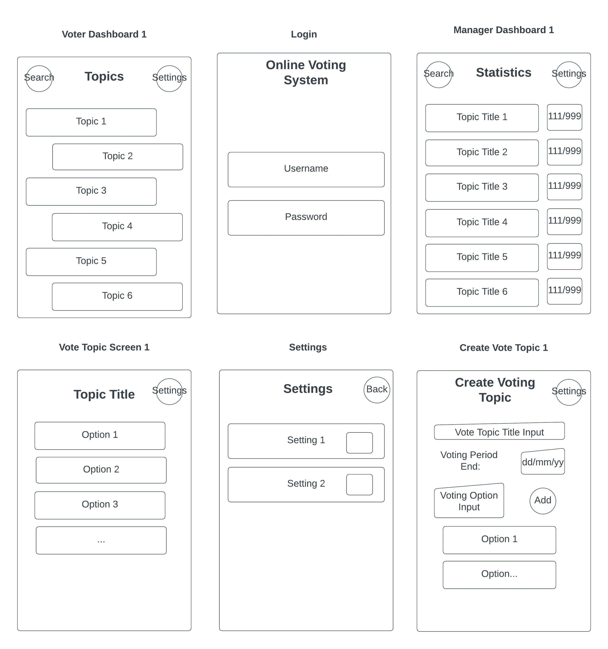
User Interface Design

Slide 12
User Interface Design

Slide 13
Standards Used
Design for Android
Notes:
https://developer.android.com/design
We tried to

Slide 14
Environmental, Social, Ethical and Safety Aspects

Slide 15
Future Work and Potential Limitations

Slide 16
Lessons Learned

Slide 17
References
https://www.techstrikers.com/MySQL/advantages-and-disadvantages-of-mysql.php
https://osdb.io/firebase-pros-and-cons-when-you-should-and-shouldnt-use-firebase-osdb/
https://developer.android.com/design

